Slide 1
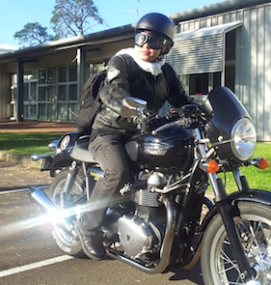
Patrick University Student (IT)
“Live life to the fullest”
High achiever
Experienced coder
Looking for job opportunities in IT
Currently recovering from motorcycle accident
Personal Profile
Patrick is attending Charles Darwin University (CDU) as an IT Student. He is hoping to find work as a software developer when he finishes his degree. He enjoys playing sports, and socialising with friends.
Patrick has heard about a coding competition held by CDU, and wants to register his interest. One of his classmates was offered employment at a previous code fair, and Patrick was hoping to find similar opportunities for himself.
Patrick recently had a motorcycle accident, and injured one of his hands.
As a result, Patrick finds it difficult to use the mouse and keyboard with fluency.
His injuries are temporary, however he is in pain and can’t focus for long.
Personal Information
Profession: Tertiary Student (IT)
Location: Darwin, NT
Age: 23
Hobbies: Indoor soccer, coding, blogging.
Favorite TV Show: Homeland
Personality: Extroverted, enjoys meeting new people.
Internet usage
Internet experience: Advanced
Primary Uses: Studies, coding, email, blogging.
Favourite Sites: Reddit, Google, WordPress
Hours online per week: 40+
Computer: Macbook Pro, ADSL2, Safari
Study information
Current qualifications: Year 12,
Literacy: High Level
IT Skills/knowledge: Advanced,
2nd year University IT, network administration, coding, database design.
User Goals
Patrick comes to the site to…
Register interest in the coding competition
Make connections with potential employers in the IT industry
Test his skills against other people in his field
Business Objectives
We want Patrick to…
Visit the site often
Be excited about the competition
Feel encouraged about finding job
opportunities
Recommend the site to friends
Review past entries
Find the website accessible with his current disabilities

